Slide 1
Statistics recap

Slide 2
Statistics recap
Types of variables
Measures of central tendency
Measures of dispersion (spread)
Covariance and correlation

Slide 3
Variables
Quantitative: measured on a suitable scale = numerical
Qualitative: defined by a characteristic = categorical
(differences between values have numerical meaning)
Continuous
any value
within a given range,
i.e., measured
Discrete
only certain values
within a given range,
i.e., counted
Nominal
categories that cannot be ranked (no order)
Ordinal
categories that follow a logical hierarchy (ordered)
e.g., age, weight, height, temperature
e.g., heads in 100 coin flips,
number of children in a family
e.g., person’s gender,
eye colour
e.g., academic grades (i.e., A, B, C)
Notes:
Numerical data: interval scale or a ratio scale
Interval scale: the differences between two consecutive numbers carry equal significance in any part of the scale, e.g. the difference between 100 and 102 cm is the same as the difference between 176 and 178 cm
Interval scale: properties of identity, magnitude, and equal intervals
Ratio scale: additional property of a true 0.
Why do we care?
Statistical methods can only be used with certain data types: Nominal - frequency / proportion
Ordinal – percentiles
Continuous – histograms, box plot

Slide 4
Measures of Central Tendency: Median
The median is the middle of the set of numbers.
To find the median:
Arrange the numbers in order.
Find the middle number.
e.g.,
2, 5, 4, 5, 3
2, 3, 4, 5, 5
Notes:
A Median is a middle value for sorted data. The sorting of the data can be done either in ascending order or descending order. A median divides the data into two equal halves.
The formula to calculate the median of the number of terms if the number of terms is even is shown in the image below:
Median Formula for Even Terms
The formula to calculate the median of the number of terms if the number of terms is odd is shown in the image below:
Median Formula for Odd Terms
Median Symbol
The letter “M” is commonly used to represent the median of a dataset, whether it’s for a population or a sample. This notation simplifies the representation of statistical concepts and calculations, making it easier to understand and apply in various contexts. Therefore, in Indian statistical practice, “M” is widely accepted and understood as the symbol for the median.
Median Formula
The formula for the median is:
If the number of values (n value) in the data set is odd then the formula to calculate the median is:
Median = [(n + 1)/2]^{th} term
Example: Find the median of given data set 30, 40, 10, 20, and 50.
Solution:
Median of the data 30, 40, 10, 20, 50 is,
Step 1: Order the given data in ascending order as:
10, 20, 30, 40, 50
Step 2: Check n (number of terms of data set) is even or odd and find the median of the data with respective ‘n’ value.
Step 3: Here, n = 5 (odd)
Median = [(n + 1)/2]^{th} term
Median = [(5 + 1)/2]^{th} term
= 30

Slide 5
The mode is the most frequently occurring number.
To find the mode:
Count how many times each value occurs.
The highest is the mode.
Measures of Central Tendency: Mode
How many?
2: 1
3: 1
4: 1
5: 2
e.g.,
2, 5, 4, 5, 3
Notes:
A mode is the most frequent value or item of the data set. A data set can generally have one or more than one mode value. If the data set has one mode then it is called “Uni-modal”. Similarly, If the data set contains 2 modes then it is called “Bimodal” and if the data set contains 3 modes then it is known as “Trimodal”. If the data set consists of more than one mode then it is known as “multi-modal”(can be bimodal or trimodal). There is no mode for a data set if every number appears only once.
The formula to calculate the mode is shown in the image below:
Formula of Median
Symbol of Mode
In statistical notation, the symbol “Z” is commonly used to represent the mode of a dataset. It indicates the value or values that occur most frequently within the dataset. This symbol is widely utilised in statistical discourse to signify the mode, enhancing clarity and precision in statistical discussions and analyses.
Mode Formula
Mode = Highest Frequency Term
Example: Find the mode of the given data set 1, 2, 2, 2, 3, 3, 4, 5.
Solution:
Given set is {1, 2, 2, 2, 3, 3, 4, 5}
As the above data set is arranged in ascending order.
By observing the above data set we can say that,
Mode = 2
As, it has highest frequency (3)

Slide 6
Measures of Central Tendency: Mean
The mean is the average – totalling all data and dividing by their number.
To find the mean:
Add the numbers together.
divide by the number of numbers.
e.g.,
2, 5, 4, 5, 3
(2+5+4+5+3)/5 = 3.8
Notes:
Mean is the sum of all the values in the data set divided by the number of values in the data set. It is also called the Arithmetic Average. Mean is denoted as x̅ and is read as x bar.
The formula to calculate the mean is:
Formula of Mean – sum of values/number of values
Mean Symbol
The symbol used to represent the mean, or arithmetic average, of a dataset is typically the Greek letter “μ” (mu) when referring to the population mean, and “x̄” (x-bar) when referring to the sample mean.
Population Mean: μ (mu)
Sample Mean: x̄ (x-bar)
These symbols are commonly used in statistical notation to represent the average value of a set of data points.
Mean Formula
The formula to calculate the mean is:
Mean (x̅) = Sum of Values / Number of Values

Slide 7
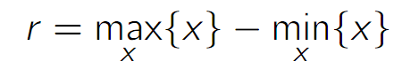
Measures of Dispersion: range
The range is the difference between the highest and lowest values.
The range is sensitive to extreme values:
Example: 2, 3, 4, 6, 7, 7, 8, 19
Range = 19 - 2 = 17
Notes:
n statistics, a range refers to the difference between the highest and lowest values in a dataset. It provides a simple measure of the spread or dispersion of the data. Calculating the range involves subtracting the minimum value from the maximum value.
Range is a fundamental statistical concept that helps us understand the spread or variability of data within a dataset. Range in Statistics provides valuable insights into the extent of variation among the values in a dataset. Range quantifies the difference between the highest and lowest values in the dataset.

Slide 8
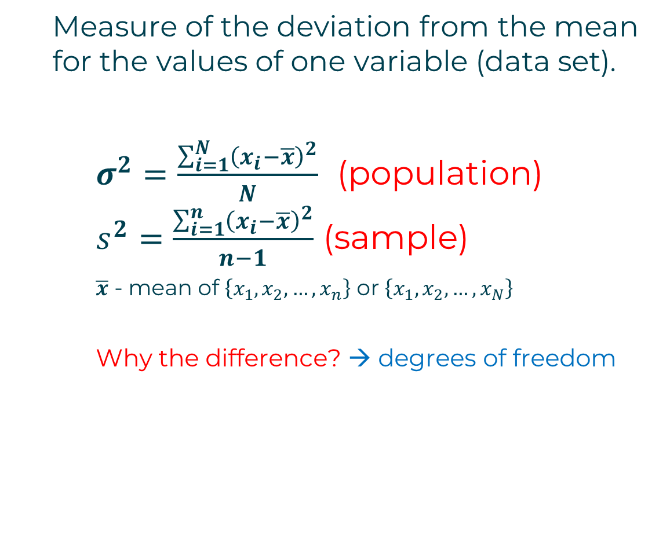
Measure of the deviation from the mean for the values of one variable (data set).
$σ^{2}=\frac{\sum_{i=1}^{N}{{\left(x_{i}−\overline{x}\right)}^{2}}}{N}$ (population) $s^{2}=\frac{\sum_{i=1}^{n}{{\left(x_{i}−\overline{x}\right)}^{2}}}{n−1}$ (sample)
$\overline{x}$ - mean of $\left\{x_{1},x_{2},…,x_{n}\right\}$ or $\left\{x_{1},x_{2},…,x_{N}\right\}$
Why the difference? → degrees of freedom
Measures
of dispersion: variance
Notes:
We measure the various values of the data and these values are used for a variety of purposes. The data can be given in two types grouped data, or ungrouped (discrete) data. If the data is given in the form of class intervals it is called grouped data whereas if the data is given in the form of a single data point it is referred to as a discrete or ungrouped data point. Variance is the measure of the dispersion of the data concerning the mean value of the data. It tells us how the data is dispersed in the given data value. We can easily calculate the sample variance and population variance for both grouped and ungrouped data.
Variance Definition
Variance is a statistical measure that quantifies the spread or dispersion of a set of data points. It indicates how much the individual data points in a dataset differ from the mean (average) of the dataset
Types of Variance
We can define the variance of the given data in two types,
Population Variance
Sample Variance
Now let’s learn about them in detail.
Population Variance
Population variance is used to find the spread of the given population. The population is defined as a group of people and all the people in that group are part of the population. It tells us about how the population of a group varies with respect to the mean population.
All the members of a group are known as the population. When we want to find how each data point in a given population varies or is spread out then we use the population variance. It is used to give the squared distance of each data point from the population mean.
Sample Variance
If the population data is very large it becomes difficult to calculate the population variance of the data set. In that case, we take a sample of data from the given data set and find the variance of that data set which is called sample variance. While calculating the sample mean we make sure to calculate the sample mean, i.e. the mean of the sample data set not the population mean. We can define the sample variance as the mean of the square of the difference between the sample data point and the sample mean.
Variance Example
We can understand the concept of variance with the help of the example discussed below.
Find the population variance of the data {4,6,8,10}
Solution:
Mean = (4+6+8+10)/4 = 7
Variance = (9+1+1+9)/4 = 20/4 = 5
Thus, the variance of the data is 5

Slide 9
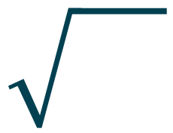
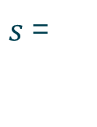
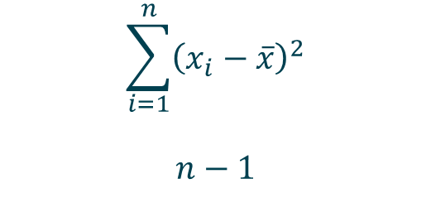
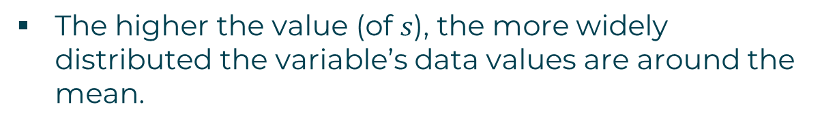
Standard deviation = Square root of the variance
Measures of dispersion: standard deviation
$$\sum_{i=1}^{n}{{\left(x_{i}−\overline{x}\right)}^{2}}$$
$$n−1$$
$s$=
The standard deviation reflects how tightly the observations cluster around the mean.
The higher the value (of $s$), the more widely distributed the variable’s data values are around the mean.
The standard deviation is measured in the same units as the data.
Notes:
Standard Deviation is the measure of the dispersion of statistics. The standard deviation formula is used to find the deviation of the data value from the mean value i.e. it is used to find the dispersion of all the values in a data set to the mean value. There are different standard deviation formulas to calculate the standard deviation of a random variable.
Standard Deviation is defined as the degree of dispersion of the data point to the mean value of the data point. It tells us how the value of the data points varies to the mean value of the data point and it tells us about the variation of the data point in the sample of the data.
Standard Deviation of a given sample of data set is also defined as the square root of the variance of the data set. Mean Deviation of the n values (say x₁, x₂, x₃, …, x_{n}) is calculated by taking the sum of the squares of the difference of each value from the mean, i.e.
Mean Deviation = 1/n∑_{i}^{n} (x_{i} – x̄)²
Mean Deviation is used to tell us about the scatter of the data. The lower degree of deviation tells us that the observations xi are close to the mean value and the depression is low. In contrast, the higher degree of deviation tells us that the observations xi are far from the mean value and the dispersion is high.
Standard Deviation Definition
Standard deviation is a measure used in statistics to understand how the data points in a set are spread out from the mean value. It indicates the extent of the data’s variation and shows how far individual data points deviate from the average.

Slide 10

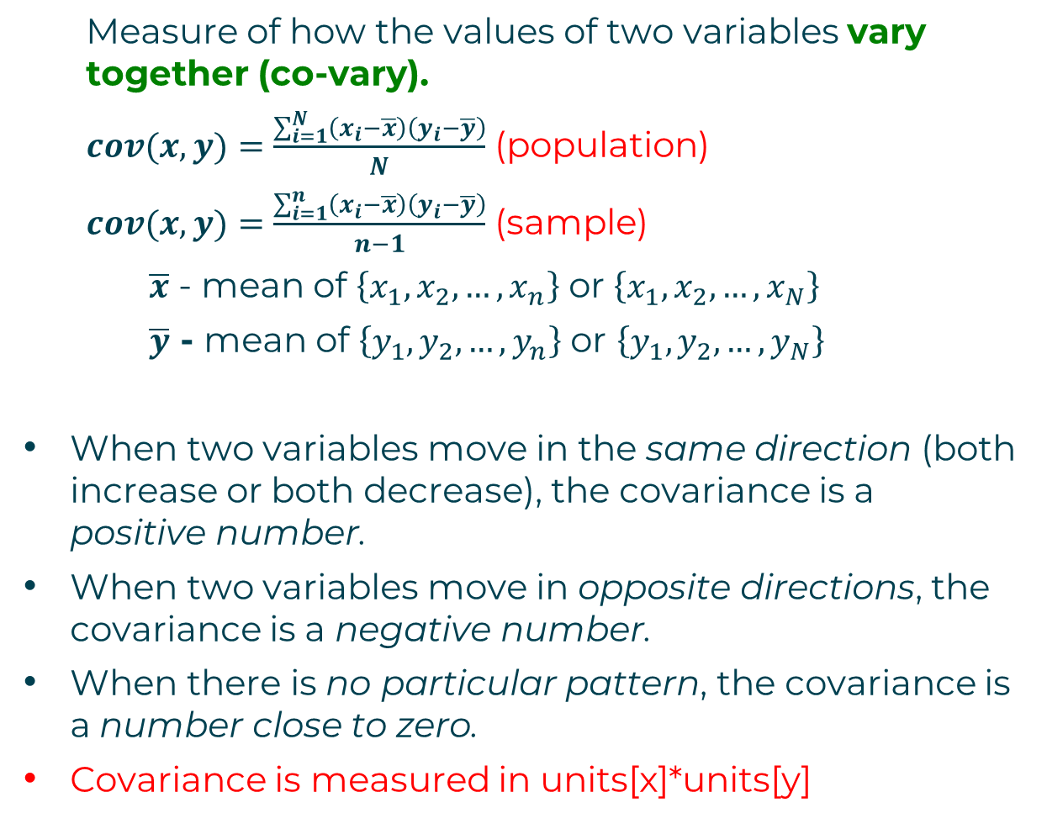
Measure of how the values of two variables vary together (co-vary).
$cov(x,y)=\frac{\sum_{i=1}^{N}{\left(x_{i}−\overline{x}\right)\left(y_{i}−\overline{y}\right)}}{N}$ (population)
$cov(x,y)=\frac{\sum_{i=1}^{n}{\left(x_{i}−\overline{x}\right)\left(y_{i}−\overline{y}\right)}}{n−1}$ (sample)
$\overline{x}$ - mean of $\left\{x_{1},x_{2},…,x_{n}\right\}$ or $\left\{x_{1},x_{2},…,x_{N}\right\}$
$\overline{y}$ - mean of $\left\{y_{1},y_{2},…,y_{n}\right\}$ or $\left\{y_{1},y_{2},…,y_{N}\right\}$
When two variables move in the same direction (both increase or both decrease), the covariance is a positive number.
When two variables move in opposite directions, the covariance is a negative number.
When there is no particular pattern, the covariance is a number close to zero.
Covariance is measured in units[x]*units[y]
covariance
Notes:
Covariance and correlation are fundamental concepts in statistics and mathematics that measure the relationship between two random variables. They are essential tools for understanding how variables change together and are widely used in various fields, including finance, economics, and science.
Covariance:
It is the relationship between a pair of random variables where change in one variable causes change in another variable.
It can take any value between – infinity to +infinity, where the negative value represents the negative relationship whereas a positive value represents the positive relationship.
It is used for the linear relationship between variables.
It gives the direction of relationship between variables.

Slide 11
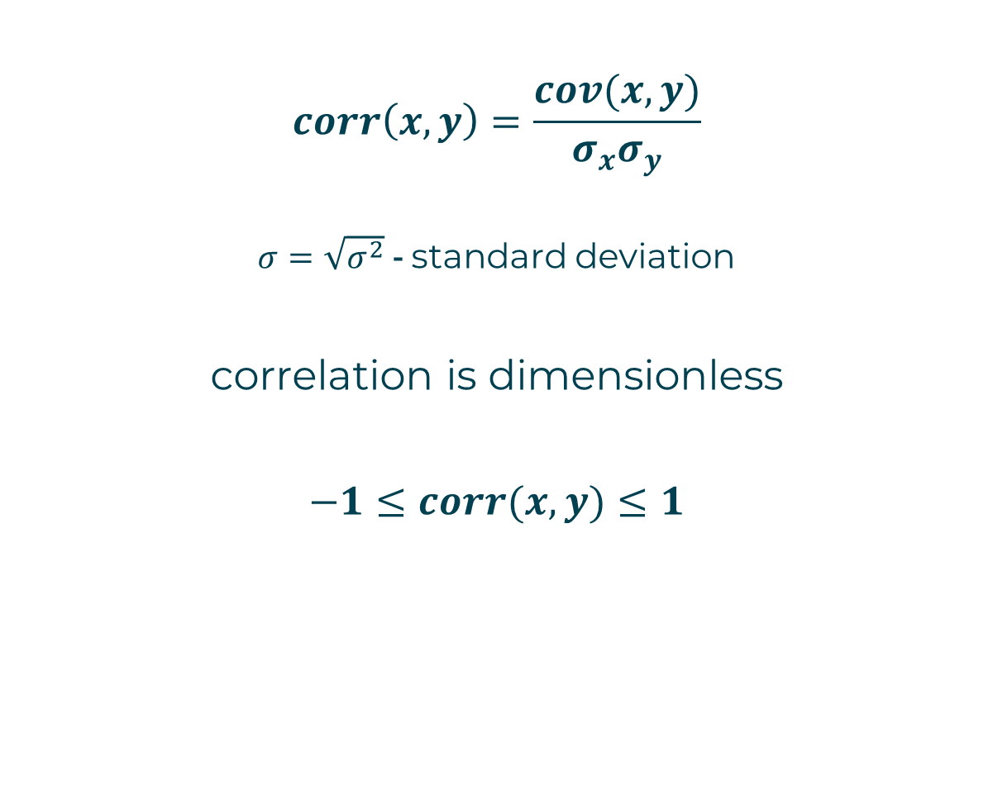
correlation
$$corr\left(x,y\right)=\frac{cov(x,y)}{σ_{x}σ_{y}}$$
$σ=\sqrt{σ^{2}}$ - standard deviation
correlation is dimensionless
$$−1≤corr(x,y)≤1$$
Notes:
Correlation is a standardized measure of the strength and direction of the linear relationship between two variables. It is derived from covariance and ranges between -1 and 1. The correlation coefficient ρ\rhoρ (rho) for variables X and Y is defined as:
It show whether and how strongly pairs of variables are related to each other.
Correlation takes values between -1 to +1, wherein values close to +1 represents strong positive correlation and values close to -1 represents strong negative correlation.
In this variable are indirectly related to each other.
It gives the direction and strength of relationship between variables.

Slide 12
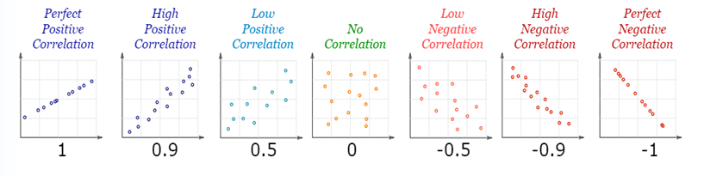
Correlation is positive when the values increase together.
Correlation is negative when one value decreases as the other increases.
A correlation is assumed to be linear (following a line).
correlation
Source: www.mathsisfun.com

